Slide 1
Big Data with Spark
Dr. Chris Teplovs
University of Michigan School of Information
Some material from Learning Spark, 2nd Edition by Jules Damji, Denny Lee, Brooke Wenig, Tathagata Das
FA2023

Slide 2
Overview
introduction to the Great Lakes high-performance computing cluster
introduction to Spark
Spark Resilient Distributed Datasets
Spark DataFrames
Spark SQL
Homework 8
Summary and next steps

Slide 3
Introduction to Spark using the Great Lakes HPC Cluster

Slide 4
How did we get here?
pandas for manipulating data
seaborn & matplotlib for visualization
nltk/spacy for text processing
dask for parallel processing of pandas DataFrames

Slide 5
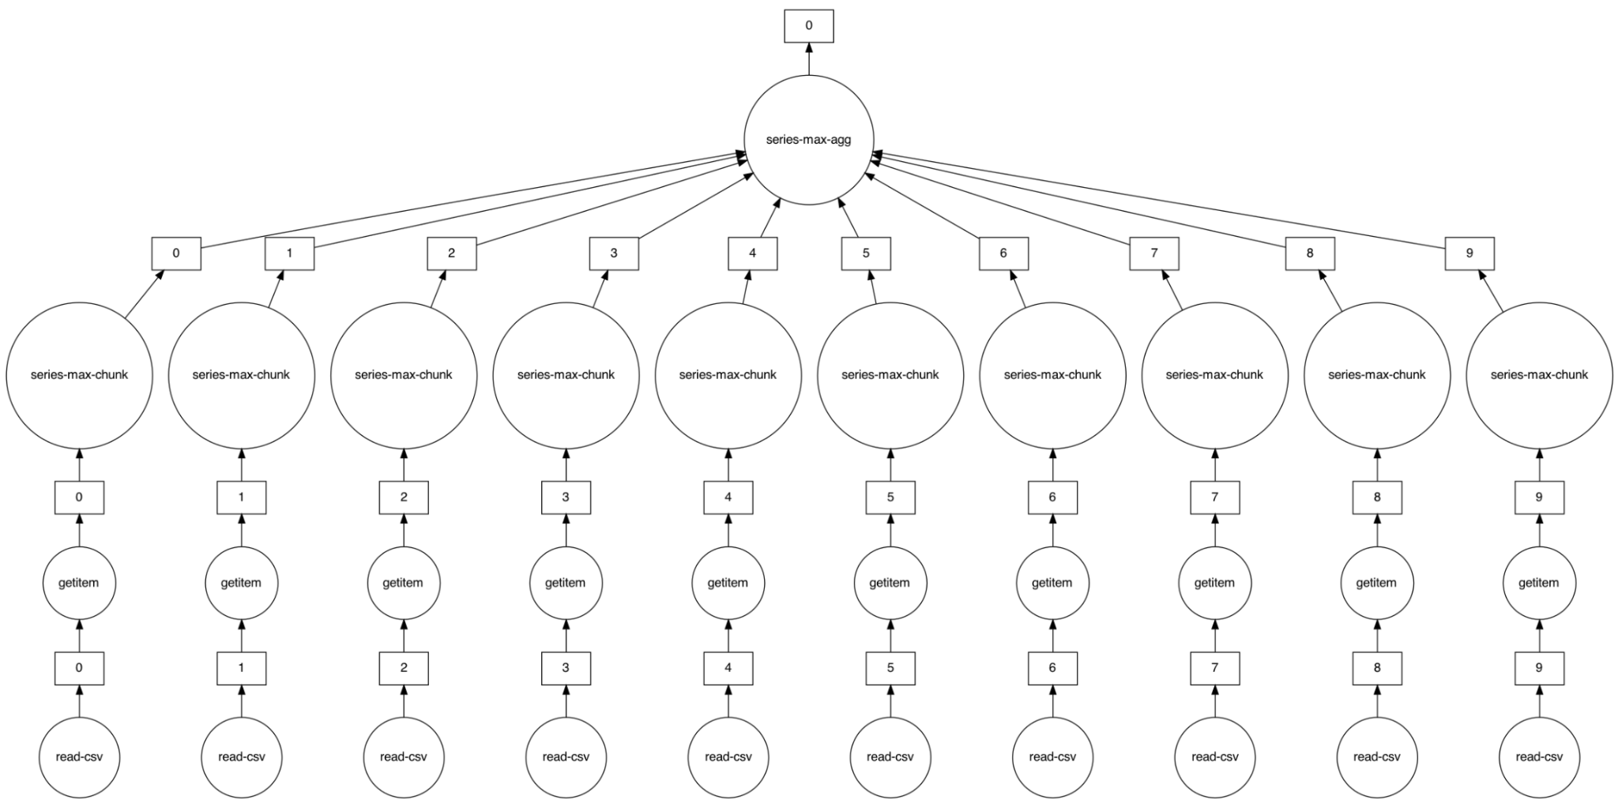
Remember dask?
df.DepDelay.max().compute()

Slide 6
Scaling up even more: Spark
"Apache Spark is a unified engine designed for large-scale distributed data processing, on premises in data centers or in the cloud."
Spark’s design philosophy centers around four key characteristics:
Speed
Ease of use
Modularity
Extensibility

Slide 7
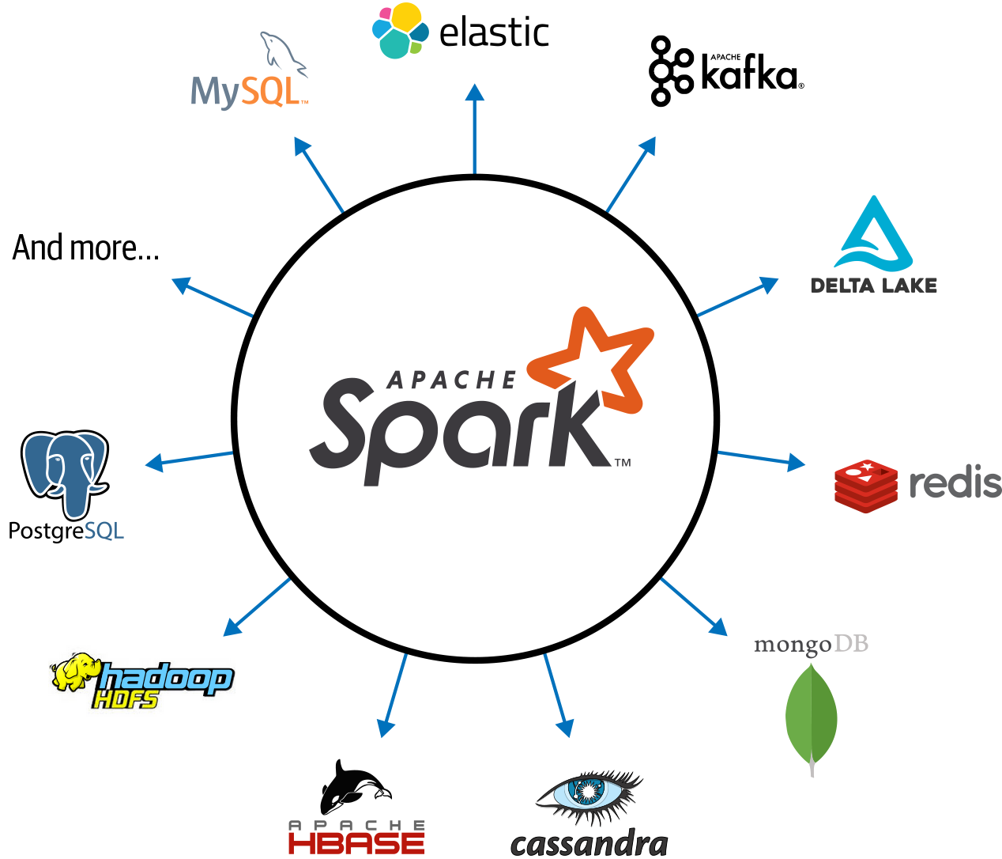
Spark connections

Slide 8
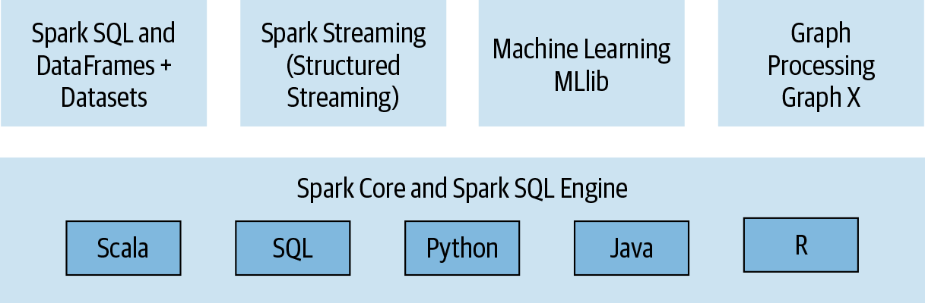
Spark components

Slide 9
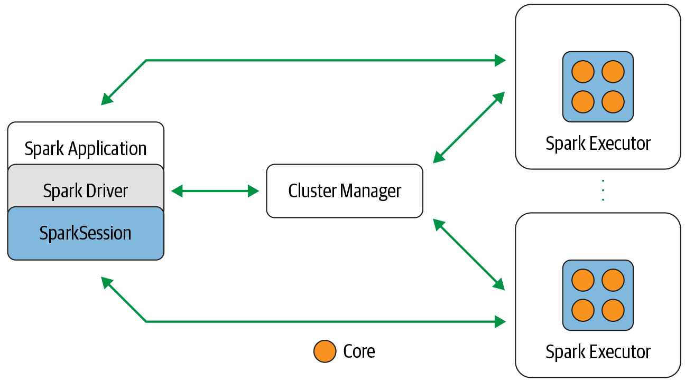
Spark components and architecture

Slide 10
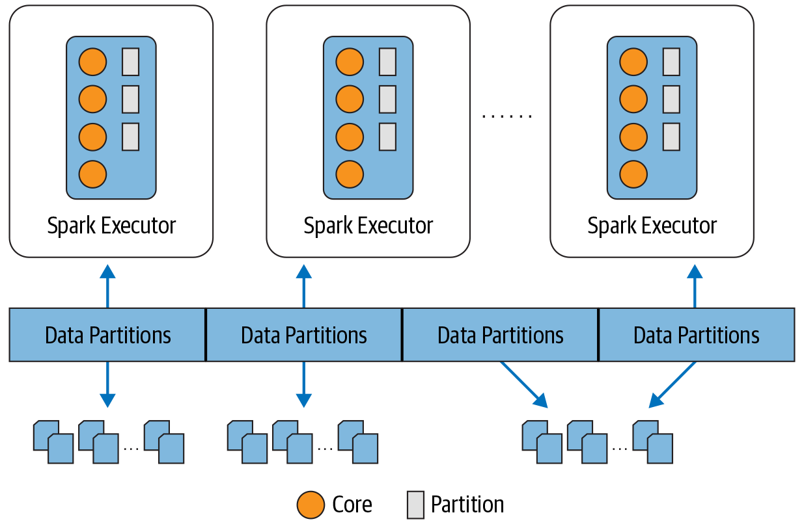
Each executor gets a partition of data to operate on

Slide 11
So… how do we make this work?
could run locally on your laptop
AWS/GCP/Azure cluster
University of Michigan's Great Lakes cluster

Slide 12
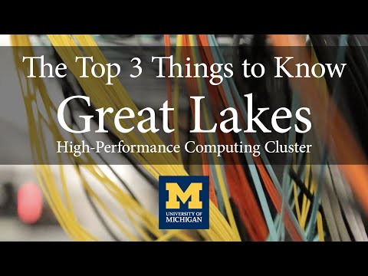
Great Lakes High Performance Computing (HPC) Cluster
13,000 cores
fast network
massive storage

Slide 13
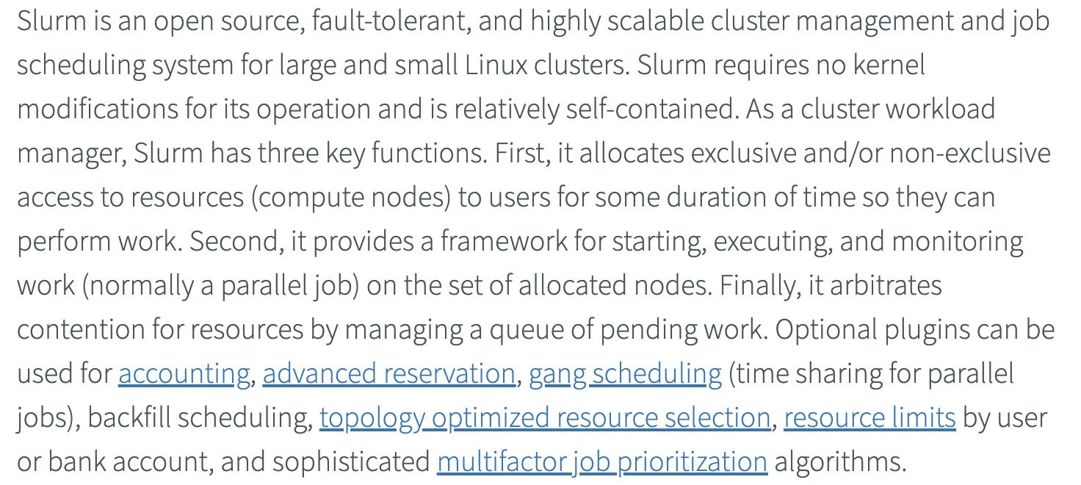
Great Lakes High Performance Computing (HPC) Cluster
technically, a "slurm" cluster
a shared system, so you have to "play nice"

Slide 14
Access to Great Lakes
must be on campus or use the University of Michigan's VPN
need Duo authentication
must have requested an account (see Slack announcement)
To log in, go to: https://greatlakes.arc-ts.umich.edu/

Slide 15
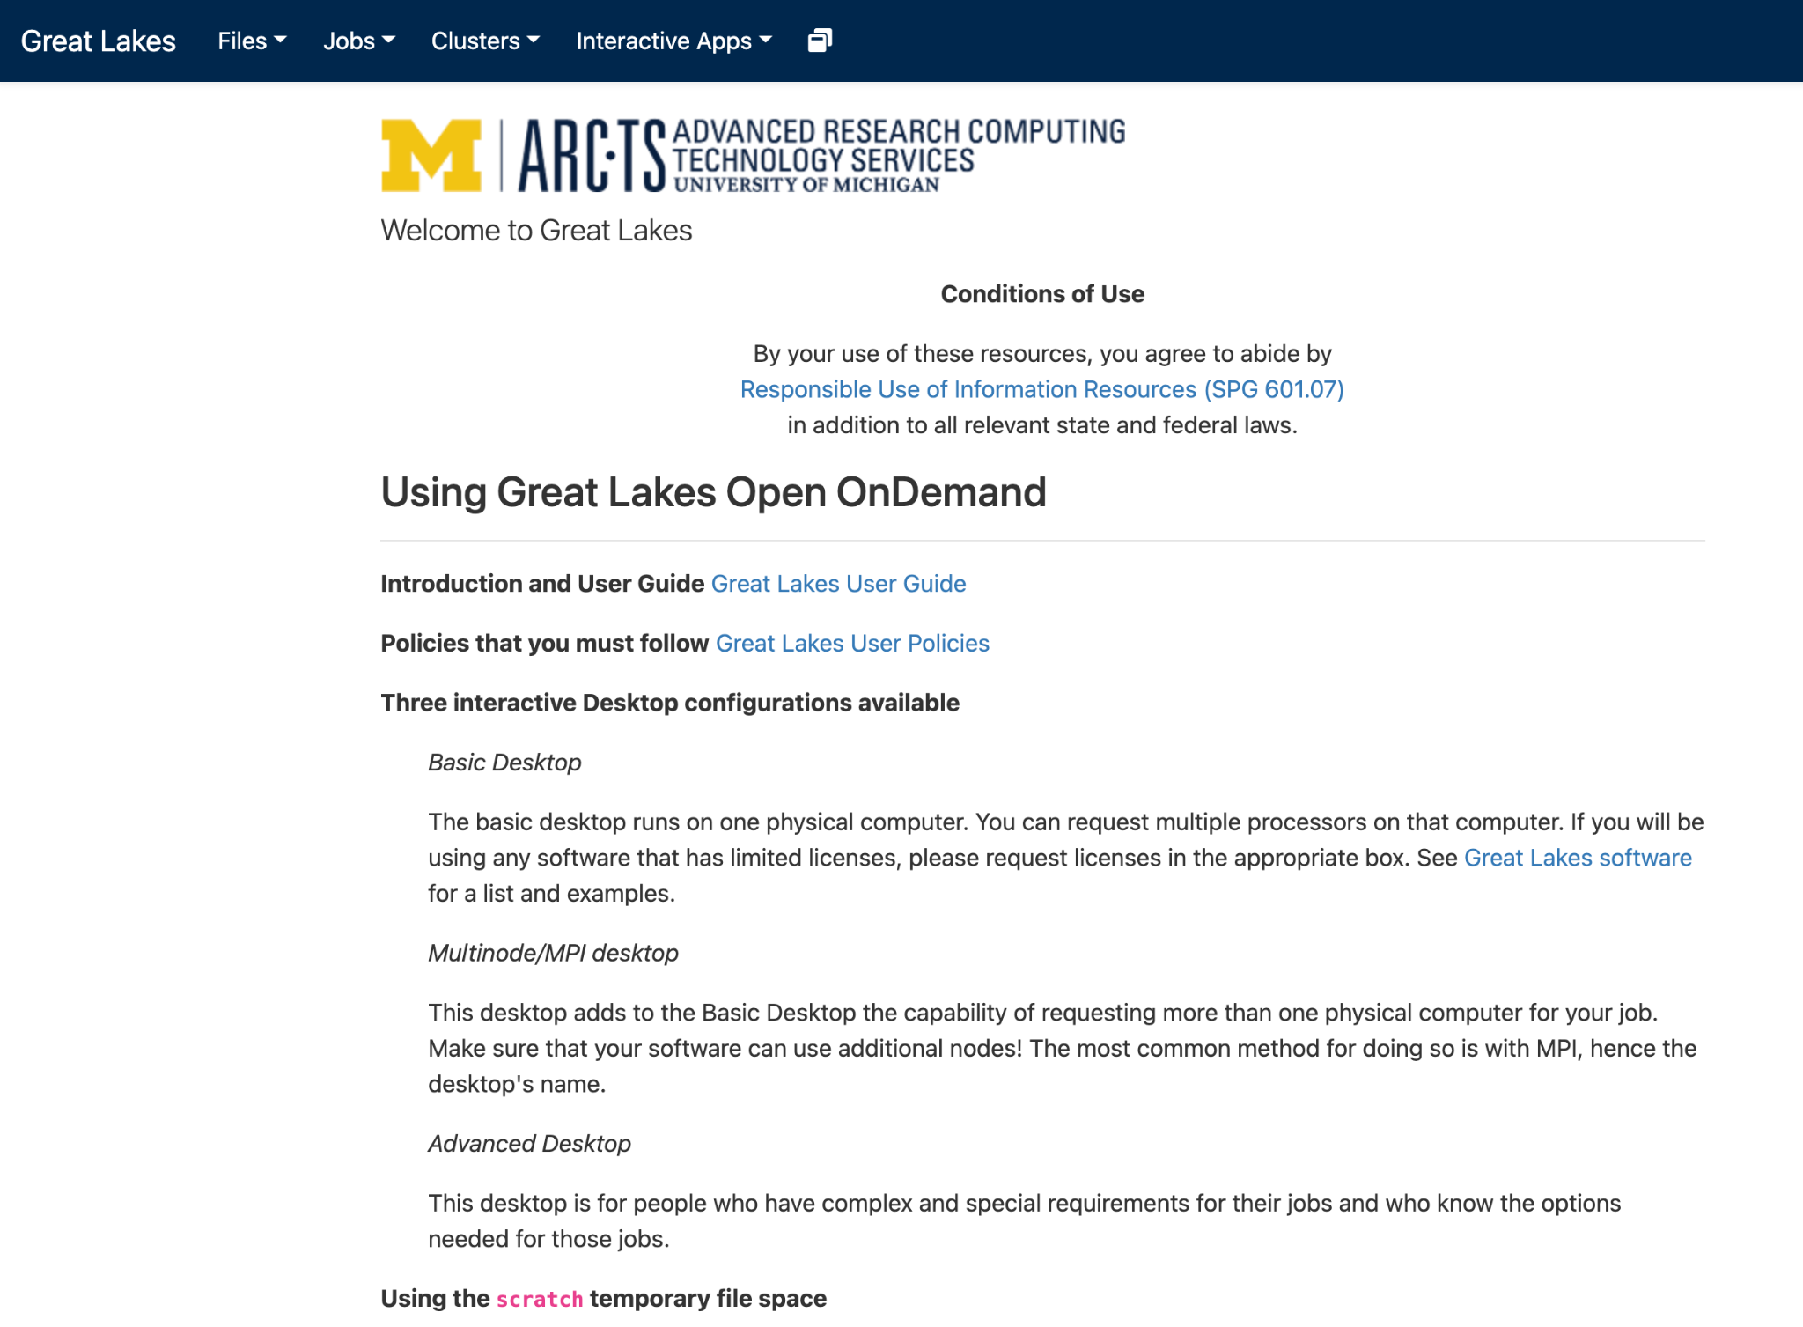
Main page
https://greatlakes.arc-ts.umich.edu/

Slide 16
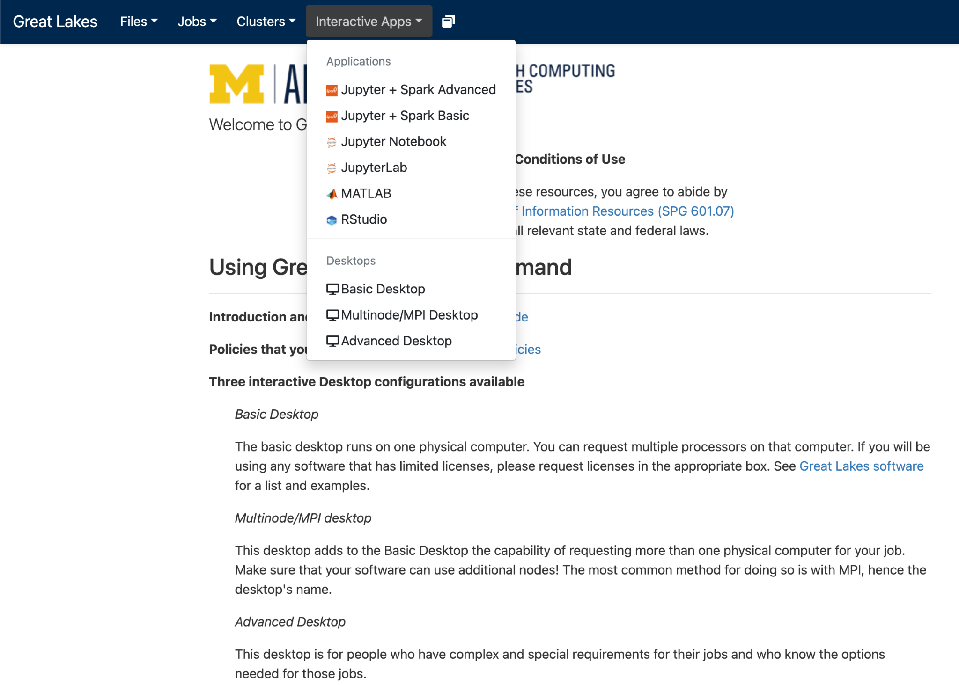
Starting a Jupyter + Spark Advanced session

Slide 17
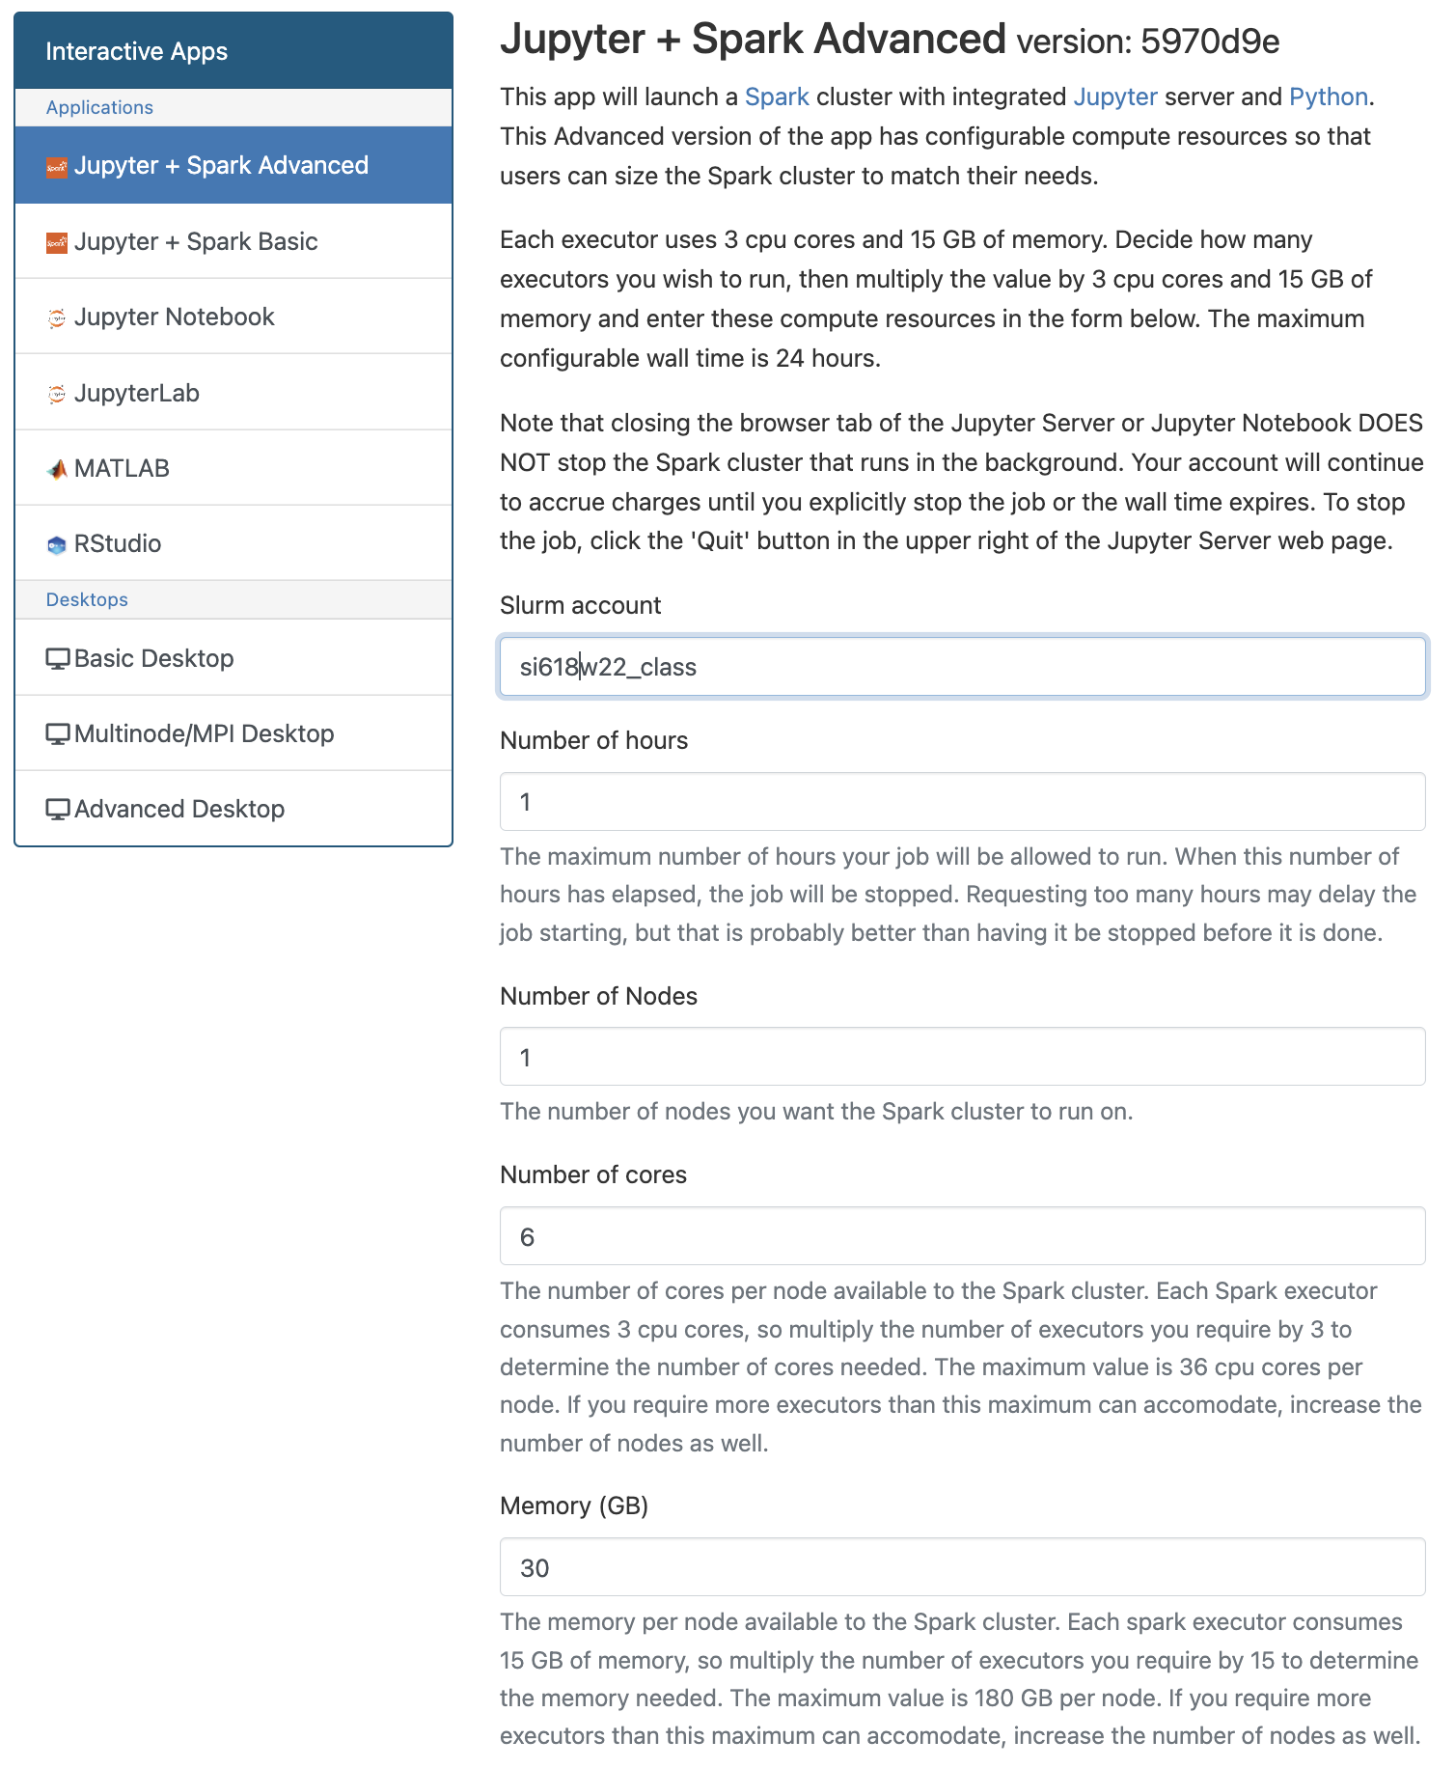
Slurm config
use "si618f23_class" for your Slurm account
select 2 hours, 1 node, 9 CPUs, and 45 GB for this class; use less if you are using this on your own, unless you know you're going to use more
click "Launch"

Slide 18
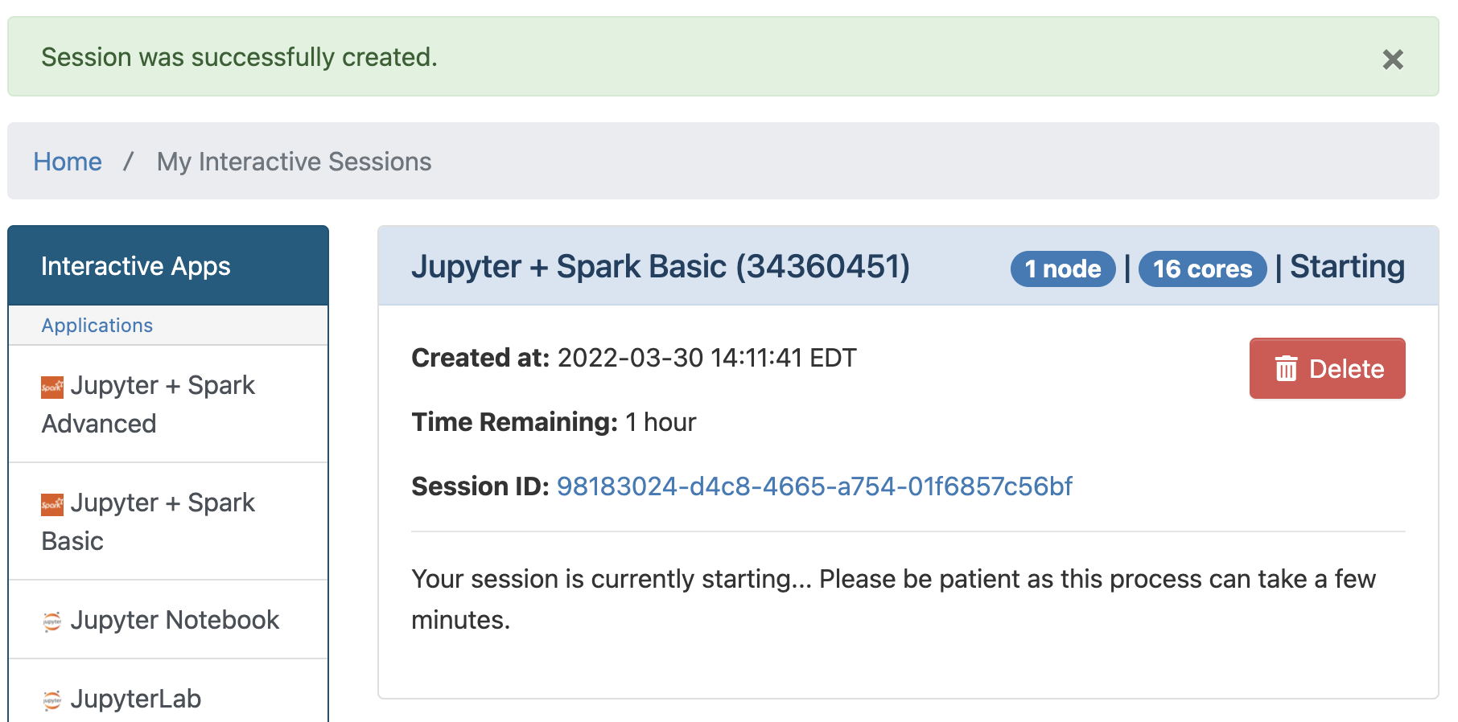
Starting a session

Slide 19
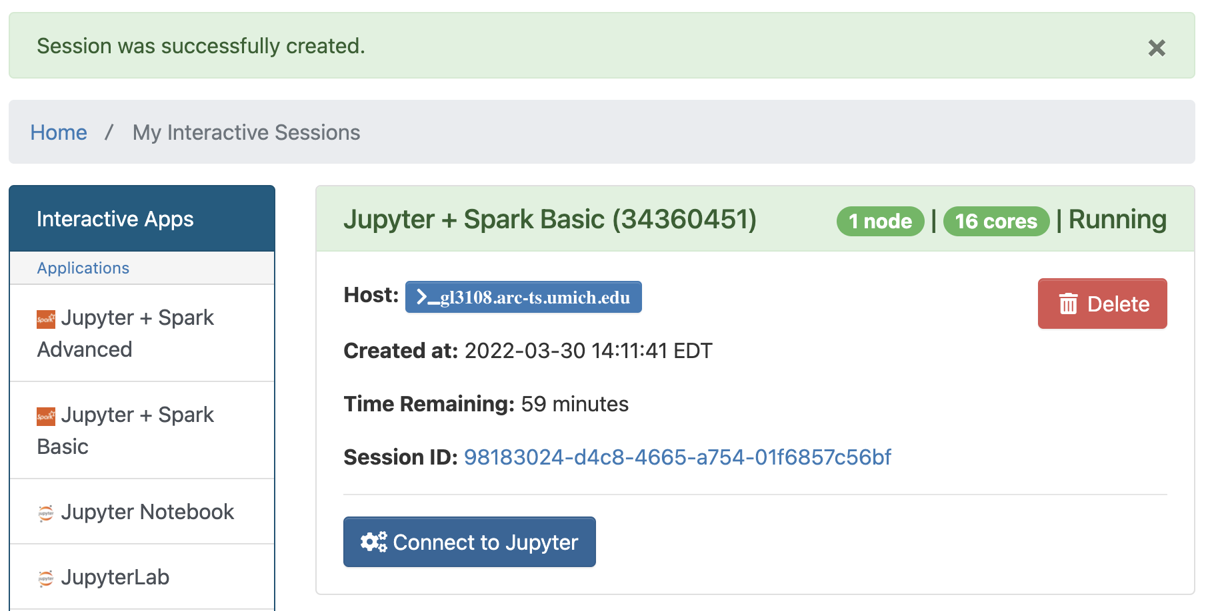
Starting a session
when it's ready, click "Connect to Jupyter"

Slide 20
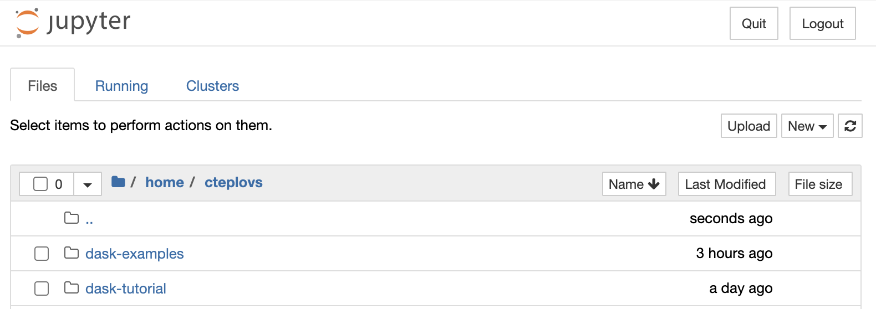
A familiar environment (your folder contents will differ)

Slide 21

Checking your usage
you have $60 for this course

Slide 22
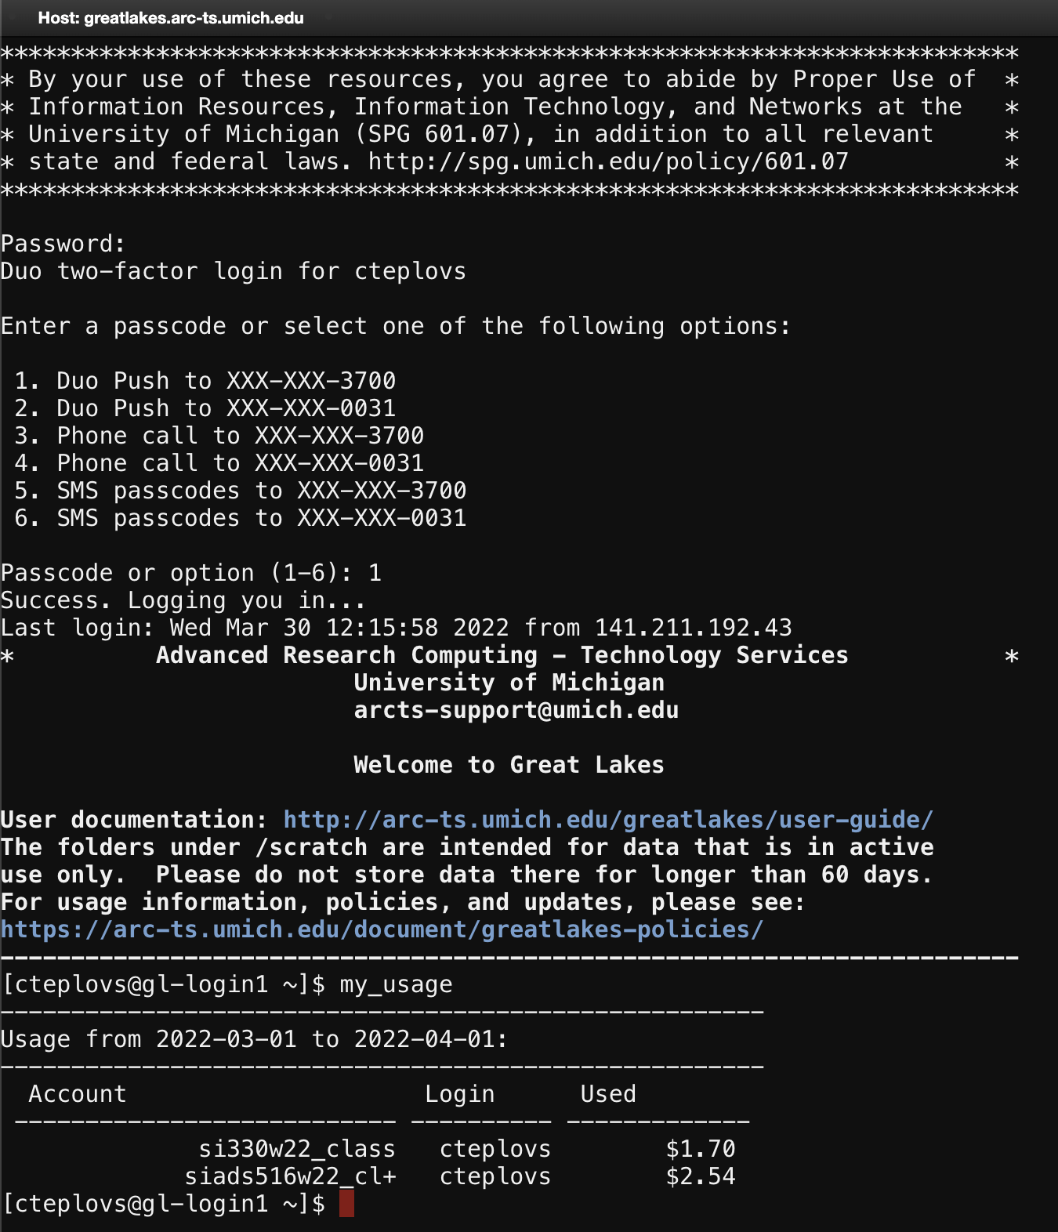
Checking your usage
you have $60 for this course

Slide 23
Next steps
feel free to experiment with Great Lakes
Or, if you don't have an account on Great Lakes yet, just download and open today's notebook on your laptop. You won't be able to use Spark, but you can follow along. Your notebook will be assessed solely on your response to the first question.

Slide 25
Introduction to Spark's Resilient Distributed Datasets (RDDs)

Slide 26
Overview
What is Spark?
The Spark stack
Basic Spark functionality: the SparkContext and Resilient Distributed Datasets (RDDs)
RDDs: Creation, Transformation, and Action
PairRDDs

Slide 27
What is Spark?
cluster computing platform
fast and general-purpose
extends MapReduce to add things like interactive queries and stream processing
supports complex workflows, which allows you to combine different types of analyses
how?

Slide 28
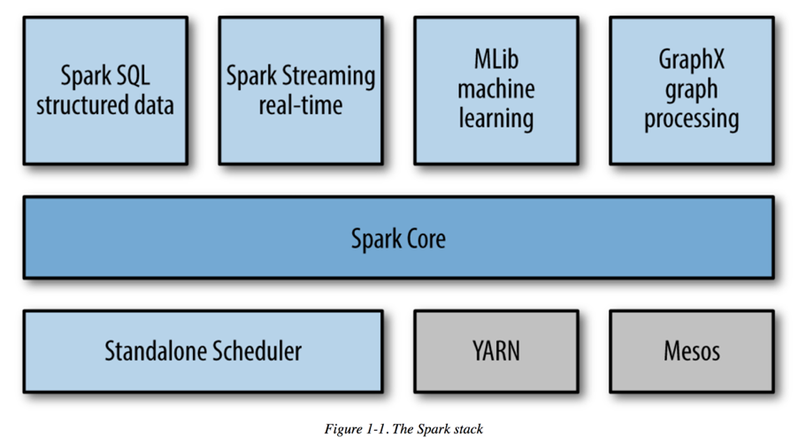
The Spark stack
Notes:
From Learning Spark, 1st edition

Slide 29
Spark Core
basic Spark functionality:
task scheduling, memory management, storage interaction, fault recovery
defines Resilient Distributed Datasets (RDDs)

Slide 30
Relationship between Spark and Hadoop
Spark does not require Hadoop, but can leverage its storage functionality (HDFS)
can also leverage Hadoop's YARN to manage compute resources

Slide 31
SparkSession and SparkContext
every Spark application has a "driver program" that's responsible for running operations on a cluster
driver programs access Spark via a SparkSession object
SparkContext is a component of a SparkSession and is what we're going to be using for this week

Slide 32
Getting set up:
in our Spark environment on GL, we "automatically" get a SparkSession object called spark
SparkContext object is automatically created from our SparkSession and is called sc
for now, we will focus on SparkContext; we will return to SparkSession next class

Slide 33
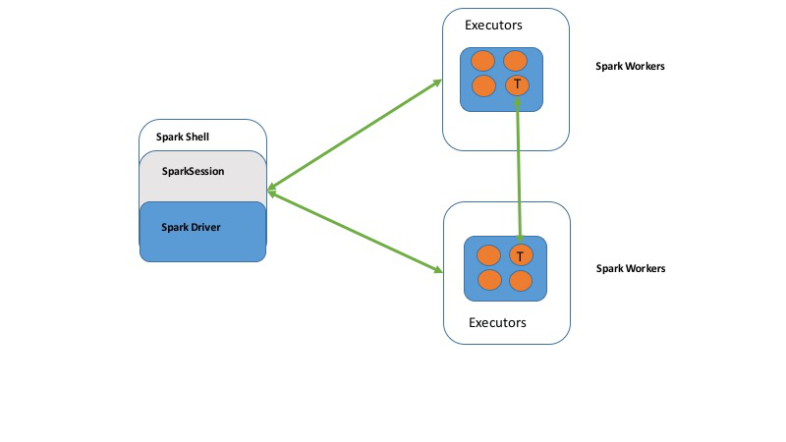
Notes:
From Learning Spark 2nd Ed.

Slide 34
Resilient Distributed Datasets (RDDs)
the fundamental abstraction for distributed data computation in Spark
immutable collection of objects that is (or can be) distributed across a cluster
can be manipulated in parallel
three basic operations: creation, transformation, and action

Slide 35
RDD Creation
can be created by reading a file (or some external resource) or by parallelizing a collection of objects (e.g. a set or list)
lines = sc.textFile("README.md")
lines = sc.parallelize(["line1", "line 2"])

Slide 36
Data partitioning
remember the general idea of parallel computing: things happen at the same time
partitioning refers to breaking the data up into parts
by default, data is broken up into partitions that are multiples of 64MB
BUT we can tune that parameter to match the number of cores on our system

Slide 37
Data partitioning
note that data can only be partitioned if it's available on all nodes of a cluster
therefore, if just reading a file from a local directory the file will not be split
more information in the readings on Hadoop Distributed File System or HDFS

Slide 38
RDD Actions
actions take data from RDDs and create non-RDD data structures
these actions move data from Spark to non-Spark
commonly used to get the results of transformations

Slide 39
RDD Actions
Commonly used actions:
count(): return number of elements
collect(): return list of all elements
take(n): retrieve first n elements
head(n): same as take
first(): retrieve first element
NOTE: be careful with collect()!!! [WHY?]

Slide 40
RDD Transformations
RDD transformations result in new RDDs
examples include filtering, mapping, and reducing

Slide 41
Filtering
consider the following text:
The University of Michigan School of Information is pleased to offer a new, fully online, master’s program in applied data science. We teach comprehensive applied data science at the intersection of people and technology. We provide critical insight into data collection, computation, and analytics, and help develop hands-on skills using a multidisciplinary approach embedded in information, computer science, and statistics. Coursework and projects focus on applying data science to real-world problems. For more information on our program and its admissions criteria, we invite you to join our interest list.

Slide 42
Filtering
let's assume each line is one complete sentence:
The University of Michigan School of Information is pleased to offer a new, fully online, master’s program in applied data science.
We teach comprehensive applied data science at the intersection of people and technology.
We provide critical insight into data collection, computation, and analytics, and help develop hands-on skills using a multidisciplinary approach embedded in information, computer science, and statistics.
Coursework and projects focus on applying data science to real-world problems.
For more information on our program and its admissions criteria, we invite you to join our interest list.

Slide 43
Filtering
Let's count the lines that contain the word "data":
lines = sc.textfile('data/blurb.txt')
data_lines = lines.filter(lambda line: 'data' in line)
data_lines.count()
data_lines.collect()

Slide 44
Filtering
data_lines = lines.filter(lambda line: 'data' in line)
could be equivalently implemented as:
def data_filter(s):
return 'data' in s
data_lines = lines.filter(data_filter)

Slide 45
Mapping
apply a function to each element
Example:
nums = sc.parallelize([1, 2, 3, 4])
squared = nums.map(lambda x: x * x).collect()
for num in squared:
print('%i ' % (num))
Notes:
The map() transformation takes in a function and applies it to each element in the RDD with the result of the function being the new value of each element in the resulting RDD.

Slide 46
Mapping
lines = sc.parallelize(["hello world", "hi"])
words = lines.map(lambda line: line.split(" "))
print(words.collect())
[['hello', 'world'], ['hi']]

Slide 47
FlatMapping
lines = sc.parallelize(["hello world", "hi"])
words = lines.flatMap(lambda line: line.split(" "))
print(words.collect())
['hello', 'world', 'hi']
Notes:
Sometimes we want to produce multiple output elements for each input element. The operation to do this is called flatMap(). As with map(), the function we provide to flatMap() is called individually for each element in our input RDD. Instead of returning a single element, we return an iterator with our return values. Rather than producing an RDD of iterators, we get back an RDD that consists of the elements from all of the iterators.

Slide 48
Set-like transformations
errorsRDD = inputRDD.filter(lambda x: "error" in x)
warningsRDD = inputRDD.filter(lambda x: "warning" in x)
badLinesRDD = errorsRDD.union(warningsRDD)
rdd1.union(rdd2)
rdd1.intersection(rdd2)
rdd1.subtract(rdd2)
rdd1.distinct()

Slide 49
PairRDDs
RDDs that consist of key-value pairs
note that "keys" are usually not unique (in contrast to python dictionaries)
PairRDDs provide additional functionality, most notably:
sortBy()
sortByKey()
reduceByKey()

Slide 50
PairRDDs: sortBy()
like the Python sorted() using a key= function
example:
word_counts_sorted = word_count3.sortBy(lambda x: x[1], ascending = False)

Slide 51
PairRDDs: sortByKey()
sorts key-value pairs by keys alphabetically
example:
word_counts_sorted = word_counts.sortByKey()

Slide 52
PairRDDs: reduceByKey()
takes a function that operates on the values of two elements with the same key and returns a new RDD
example:
sumRDD = rdd.reduceByKey(lambda accumulator, value: accumulator + value)

Slide 53
Word count example
input_file = sc.textFile("data/totc.txt")
word_count1 = input_file.flatMap(lambda line: line.split())
word_count2 = word_count1.map(lambda word: (word, 1))
word_count3 = word_count2.reduceByKey(lambda a, b: a + b)
word_counts_sorted = word_count3.sortBy(lambda x: x[1], ascending = False)
word_counts_sorted.take(10)

Slide 55
Spark DataFrames

Slide 56

Overview
Spark DataFrames
Creation
Schemas
Column selection
Sort filter, groupBy

Slide 57
Spark APIs
Three APIs:
RDDs (last class)
DataSets
DataFrames

Slide 58
Spark RDDs:
Resilient Distributed Datasets
Low-level
Support creation, transformations, and actions
Creation:
parallelize() an existing data structure; load a file with textFile()
transformations return a new RDD (e.g. map(), reduce())
Actions return non-RDDs (e.g. count(), collect()

Slide 59
Spark Datasets
Distributed collection of data
Only available via Scala and Java
(i.e. no Python interface)
We will not be using Datasets

Slide 60
Spark Dataframes
Our main focus will be on Spark DataFrames
DataFrames are Spark Datasets organized into named columns (sound familiar?)
They’re tables
conceptually very similar to Pandas and R DataFrames

Slide 61
Spark Dataframes: Getting Started
from pyspark.sql import SparkSession
spark = SparkSession \
.builder \
.appName("Python Spark SQL basic example")\
.getOrCreate()
all interaction is via
a SparkSession:
entry point to programming Spark with the DataFrame API
to create a SparkSession, use the builder pattern shown above
on GL, you already have a SparkSession (spark)

Slide 62
Creating Spark Dataframes
once you have a SparkSession you can create a DataFrame
a DataFrame can be created from:
a list
an RDD
a specially-formatted JSON file

Slide 63
Creating A Dataframe From A List
list of tuples: include a list of column names
list of values: specify value type
# create a DataFrame from a list of tuples
df_from_other_list = spark.createDataFrame(
[('Chris',67),('Frank',70)], [‘name','score'])
df_from_other_list.show()
+-----+-----+
| name|score|
+-----+-----+
|Chris| 67|
|Frank| 70|
+-----+-----+
# create a DataFrame from a list of values;
# note that you must specify the data type
from pyspark.sql.types import FloatType
df_from_list = spark.createDataFrame(
[1.0,2.0,3.0,4.0,5.0], FloatType())
df_from_list.show()
+-----+
|value|
+-----+
| 1.0|
| 2.0|
| 3.0|
| 4.0|
| 5.0|
+-----+

Slide 64
Creating A Dataframe From An RDD
# create a DataFrame from an RDD
dfPeople = spark.createDataFrame(lot_rdd)
dfPeople.show()
# create a Row to include column names
from pyspark.sql import Row
lot_rdd_named_columns = lot_rdd \
.map(lambda x: Row(name=x[0], score=int(x[1])))
dfPeople_named_columns = spark \
.createDataFrame(lot_rdd_named_columns)
dfPeople_named_columns.show()
+-----+---+
| _1| _2|
+-----+---+
|Chris| 67|
|Frank| 70|
+-----+---+
+-----+-----+
| name|score|
+-----+-----+
|Chris| 67|
|Frank| 70|
+-----+-----+
simple of you’re ok with default column names
need to create a pyspark.sql.Row if you
want better column names
# create an RDD
from pyspark import SparkContext
sc = SparkContext.getOrCreate()
lot_rdd = sc.parallelize([('Chris',67),('Frank',70)])

Slide 65
Creating A Dataframe From A JSON File
# read a specially formatted JSON file (one JSON object per line)
df = spark.read.json("business.json")
# Displays the content of the DataFrame to stdout
df.show()
+--------------------+--------------------+--------------------+--------------------+--------------+--------------------+-------+-------------+--------------+--------------------+------------------+-----------+------------+-----+-----+
| address| attributes| business_id| categories| city| hours|is_open| latitude| longitude| name| neighborhood|postal_code|review_count|stars|state|
+--------------------+--------------------+--------------------+--------------------+--------------+--------------------+-------+-------------+--------------+--------------------+------------------+-----------+------------+-----+-----+
|4855 E Warner Rd,...|[true,null,null,n...|FYWN1wneV18bWNgQj...|[Dentists, Genera...| Ahwatukee|[7:30-17:00,7:30-...| 1| 33.3306902| -111.9785992| Dental by Design|

Slide 66
Inferring Schema
root
|-- address: string (nullable = true)
|-- attributes: struct (nullable = true)
| |-- AcceptsInsurance: boolean (nullable = true)
| |-- AgesAllowed: string (nullable = true)
| |-- Alcohol: string (nullable = true)
| |-- Ambience: struct (nullable = true)
| | |-- casual: boolean (nullable = true)
| | |-- classy: boolean (nullable = true)
| | |-- divey: boolean (nullable = true)
| | |-- hipster: boolean (nullable = true)
| | |-- intimate: boolean (nullable = true)
| | |-- romantic: boolean (nullable = true)
| | |-- touristy: boolean (nullable = true)
| | |-- trendy: boolean (nullable = true)
| | |-- upscale: boolean (nullable = true)
| |-- BYOB: boolean (nullable = true)
| |-- BYOBCorkage: string (nullable = true)
| |-- BestNights: struct (nullable = true)
| | |-- friday: boolean (nullable = true)
| | |-- monday: boolean (nullable = true)
| | |-- saturday: boolean (nullable = true)
| | |-- sunday: boolean (nullable = true)
| | |-- thursday: boolean (nullable = true)
| | |-- tuesday: boolean (nullable = true)
| | |-- wednesday: boolean (nullable = true)
From previous example, df.printSchema() gives:
|-- is_open: long (nullable = true)
|-- latitude: double (nullable = true)
|-- longitude: double (nullable = true)
|-- name: string (nullable = true)
|-- neighborhood: string (nullable = true)
|-- postal_code: string (nullable = true)
|-- review_count: long (nullable = true)
|-- stars: double (nullable = true)
|-- state: string (nullable = true)

Slide 67
Creating A Dataframe From A File
(General)
Spark can load a number of different formats: json, parquet, jdbc, orc, libsvm, csv, text
df = spark.read.load("examples/src/main/resources/people.json", format=“json")

Slide 68
Describing a DataFrame
df.columns
df.dtypes
df.describe.show()

Slide 69
Column Selection
# Select only the "name" column
df.select("name").show()
+--------------------+
| name|
+--------------------+
| Dental by Design|
| Stephen Szabo Salon|
|Western Motor Veh...|
| Sports Authority|
|Brick House Taver...|
| Messina|
| BDJ Realty|
| Soccer Zone|
| Any Given Sundae|
|Detailing Gone Mo...|
| East Coast Coffee|
|CubeSmart Self St...|
|T & T Bakery and ...|
|Complete Dental Care|
|Showmars Governme...|
| Alize Catering|
| T & Y Nail Spa|
|Meineke Car Care ...|
|Senior's Barber Shop|
|Maxim Bakery & Re...|
+--------------------+
only showing top 20 rows

Slide 70
Column Selection with Manipulation
# Select all businesses, but increment the review_count by 1
df.select(df['name'], df['review_count'] + 1).show()
+--------------------+------------------+
| name|(review_count + 1)|
+--------------------+------------------+
| Dental by Design| 23|
| Stephen Szabo Salon| 12|
|Western Motor Veh...| 19|
| Sports Authority| 10|
|Brick House Taver...| 117|
| Messina| 6|
| BDJ Realty| 6|
| Soccer Zone| 10|
| Any Given Sundae| 16|
|Detailing Gone Mo...| 8|
| East Coast Coffee| 4|
|CubeSmart Self St...| 24|
|T & T Bakery and ...| 39|
|Complete Dental Care| 6|
|Showmars Governme...| 8|
| Alize Catering| 13|
| T & Y Nail Spa| 21|
|Meineke Car Care ...| 10|
|Senior's Barber Shop| 66|
|Maxim Bakery & Re...| 35|
+--------------------+------------------+
only showing top 20 rows

Slide 71
Creating new columns
df.withColumn('new',df['old']+1)

Slide 72
Dropping columns
df.drop('someColumn')

Slide 73
Filtering
# Select businesses with 4 or more stars
df.filter(df['stars'] >= 4).show()

Slide 74
result = df.filter(someCondition).collect()
row = result[0]
row.asDict().values()
for item in result[0]: print(item) for item in result[0].asDict(): print(item) for item in result[0].asDict().keys(): print(item)

Slide 75
GroupBy and Sorting
# Count businesses by stars
df.groupBy("stars").count().show()
+-----+-----+
|stars|count|
+-----+-----+
| 3.5|32038|
| 4.5|24796|
| 2.5|16148|
| 1.0| 3788|
| 4.0|33492|
| 3.0|23142|
| 2.0| 9320|
| 1.5| 4303|
| 5.0|27540|
+-----+-----+
# Count businesses by stars and sort the output
df.groupBy("stars").count().sort("stars",ascending=False).show()
+-----+-----+
|stars|count|
+-----+-----+
| 5.0|27540|
| 4.5|24796|
| 4.0|33492|
| 3.5|32038|
| 3.0|23142|
| 2.5|16148|
| 2.0| 9320|
| 1.5| 4303|
| 1.0| 3788|
+-----+-----+

Slide 76
Renaming columns
df.withColumnRenamed('old','new').show()
df.toDF('col1','col2')

Slide 77
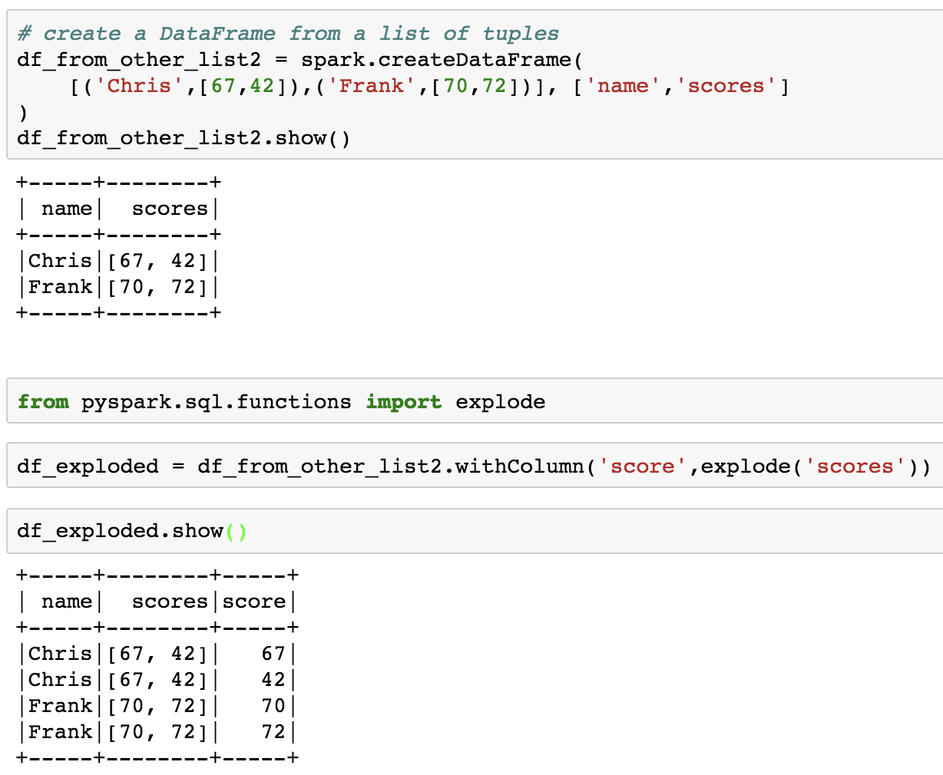
Explode
create a row for each value in a list/array/etc.

Slide 78
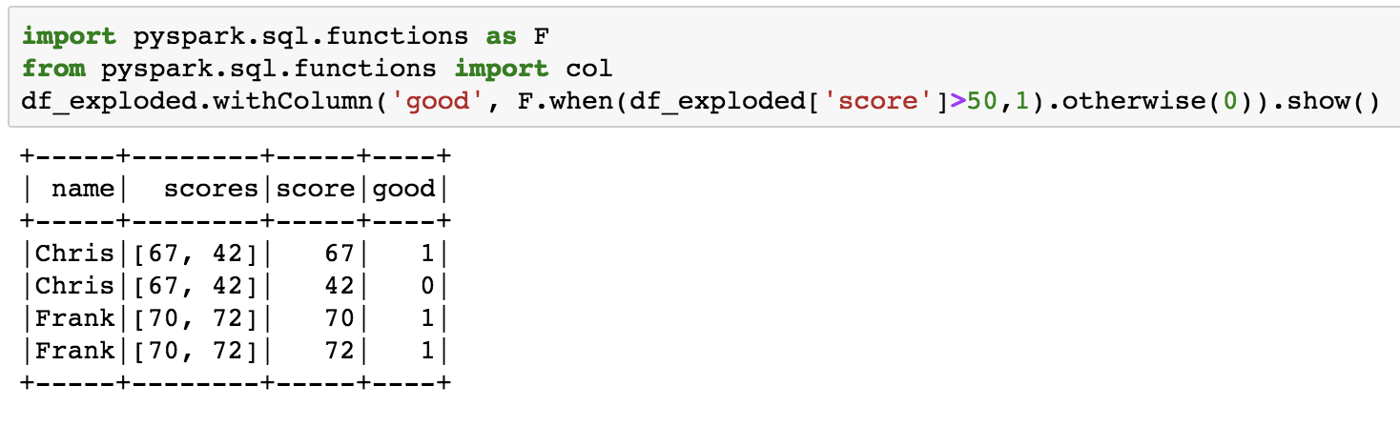
When... Otherwise

Slide 79
Join
people.filter(people.age > 30).join(department, people.deptId == department.id) \
.groupBy(department.name, "gender").agg({"salary": "avg", "age": "max"})

Slide 80
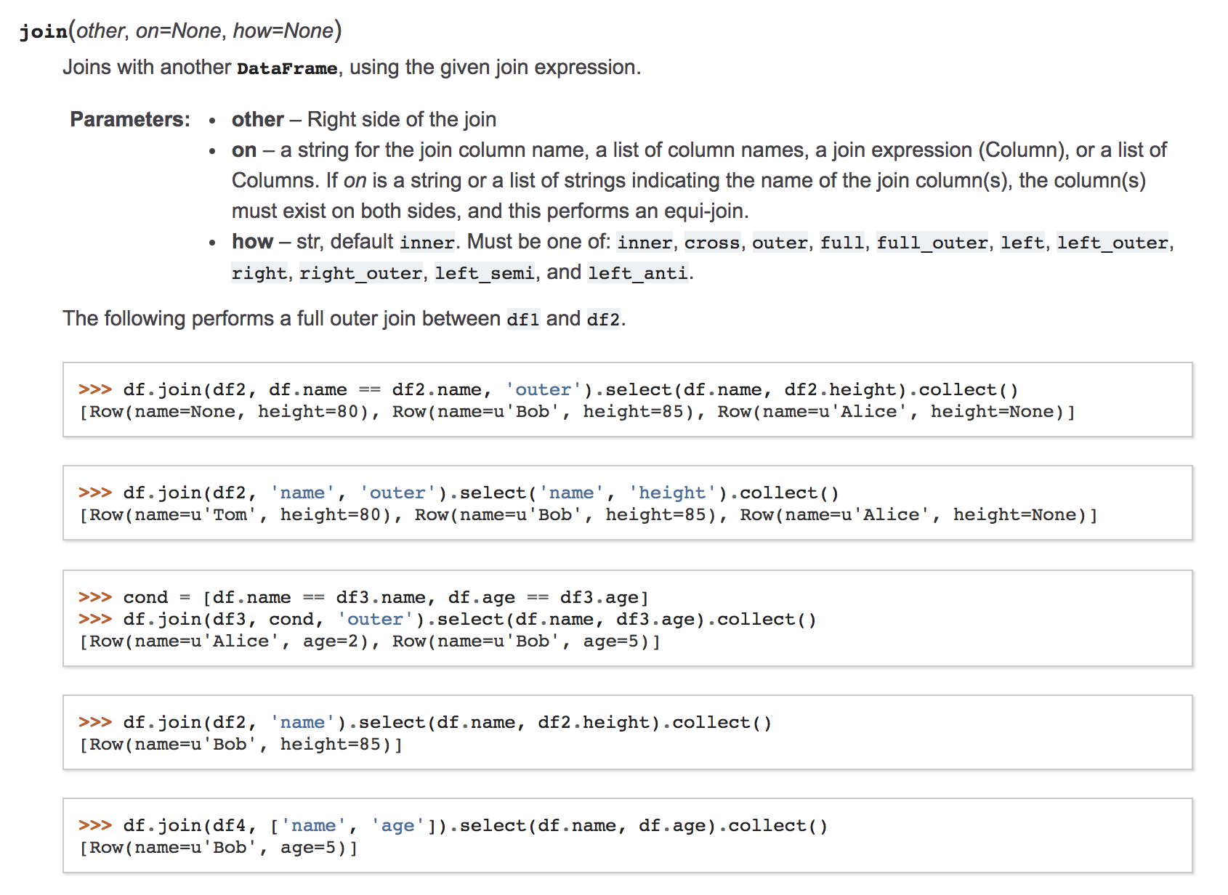
Join

Slide 81

SQL Joins

Slide 82
One more thing… debugging Spark
https://learning.oreilly.com/videos/debugging-apache-spark/9781492039174/

Slide 84
Spark SQL

Slide 85
Overview
Spark DataFrames (Review)
Spark SQL
registering temporary views
SQL review

Slide 86
Spark Dataframes
Our main focus will be on Spark DataFrames
DataFrames are Spark Datasets organized into named columns (sound familiar?)
They’re tables
conceptually very similar to Pandas and R DataFrames

Slide 87
Column Selection
# Select only the "name" column
df.select("name").show()
+--------------------+
| name|
+--------------------+
| Dental by Design|
| Stephen Szabo Salon|
|Western Motor Veh...|
| Sports Authority|
|Brick House Taver...|
| Messina|
| BDJ Realty|
| Soccer Zone|
| Any Given Sundae|
|Detailing Gone Mo...|
| East Coast Coffee|
|CubeSmart Self St...|
|T & T Bakery and ...|
|Complete Dental Care|
|Showmars Governme...|
| Alize Catering|
| T & Y Nail Spa|
|Meineke Car Care ...|
|Senior's Barber Shop|
|Maxim Bakery & Re...|
+--------------------+
only showing top 20 rows

Slide 88
Filtering
# Select businesses with 4 or more stars
df.filter(df['stars'] >= 4).show()

Slide 89
GroupBy and Sorting
# Count businesses by stars
df.groupBy("stars").count().show()
+-----+-----+
|stars|count|
+-----+-----+
| 3.5|32038|
| 4.5|24796|
| 2.5|16148|
| 1.0| 3788|
| 4.0|33492|
| 3.0|23142|
| 2.0| 9320|
| 1.5| 4303|
| 5.0|27540|
+-----+-----+
# Count businesses by stars and sort the output
df.groupBy("stars").count().sort("stars",ascending=False).show()
+-----+-----+
|stars|count|
+-----+-----+
| 5.0|27540|
| 4.5|24796|
| 4.0|33492|
| 3.5|32038|
| 3.0|23142|
| 2.5|16148|
| 2.0| 9320|
| 1.5| 4303|
| 1.0| 3788|
+-----+-----+

Slide 90
User-defined functions (UDFs)
similar to map and apply in pandas
wrapping plain old python functions
need to specify output type
Notes:
For Chris's info only: (https://changhsinlee.com/pyspark-udf/)

Slide 91
What if you need something more powerful?
more complex filtering?
more expressive language options?
how about a SQL interface to your data (without having to load it into a database?

Slide 92
We can create a "view" onto our DataFrames
every Spark DataFrame can have a view created
can be temporary or permanent
permanent views require more configuration
we are going to use temporary views that disappear after our SparkSession ends

Slide 93
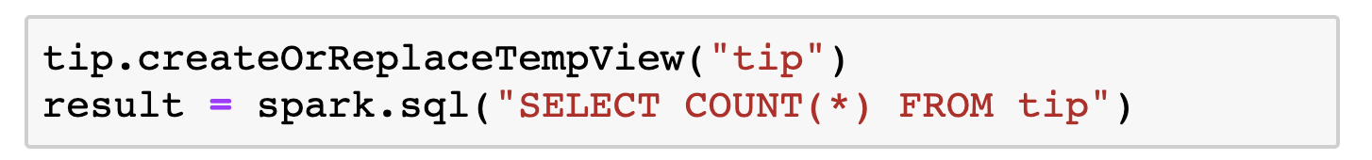
Spark SQL
once we have a temp view, we can use it to issue SQL queries via the SparkSession object
for example (note naming convention)

Slide 94
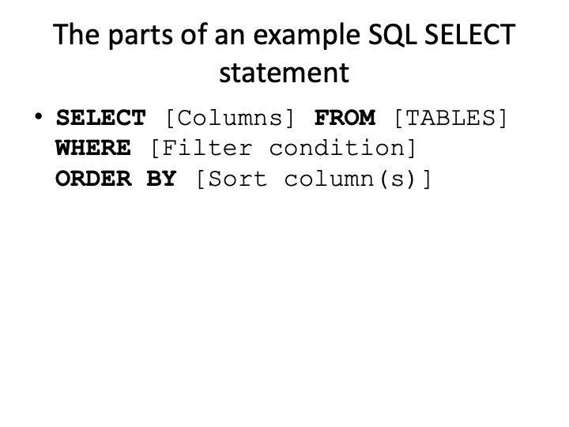

Slide 95
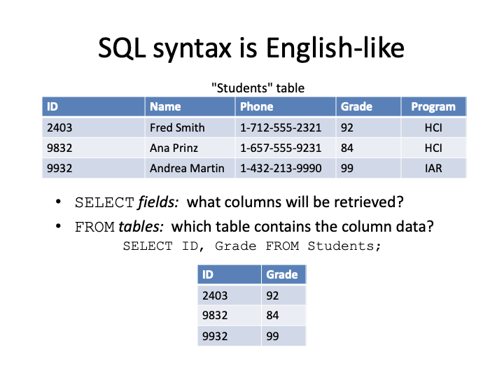

Slide 96
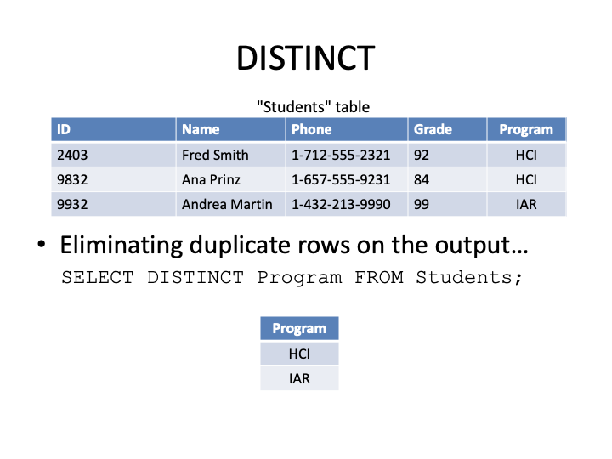

Slide 97
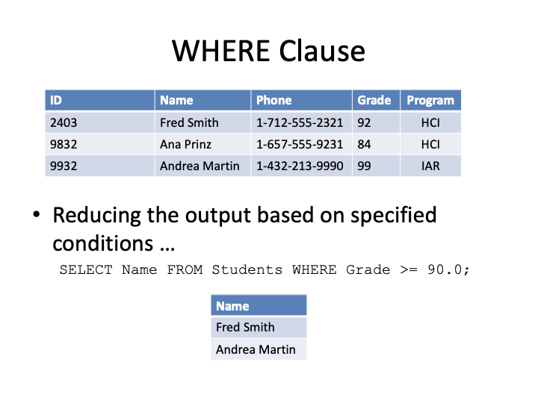

Slide 98
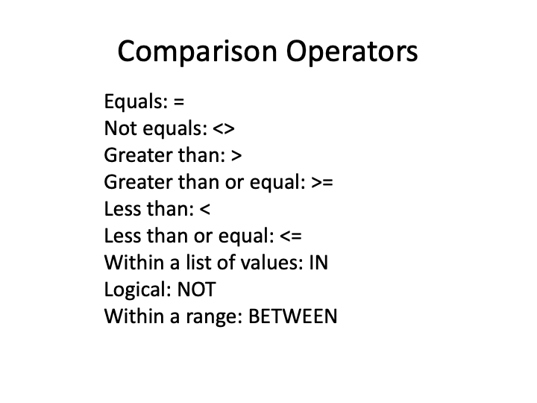

Slide 99
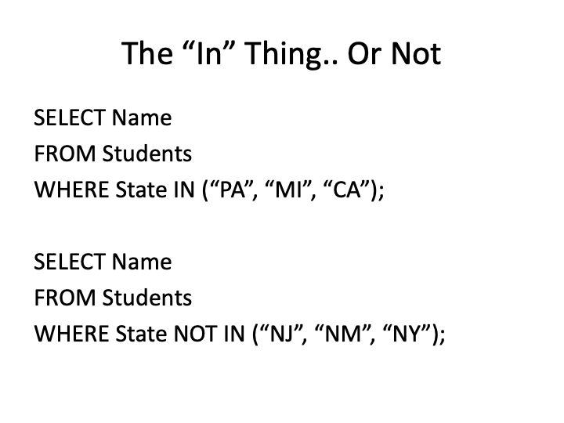

Slide 100
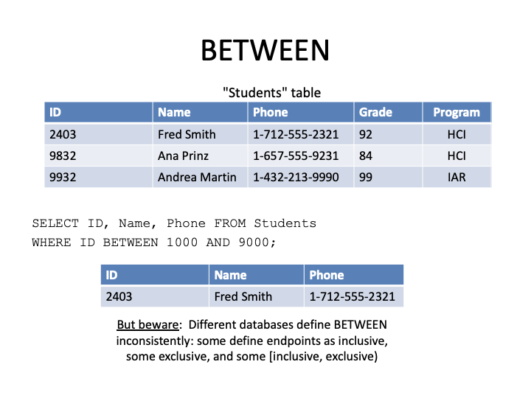

Slide 101
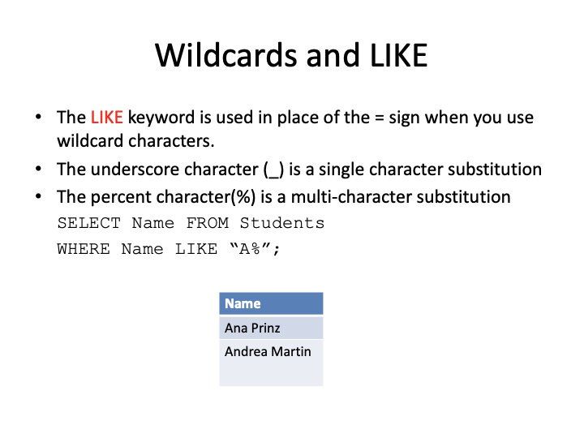

Slide 102
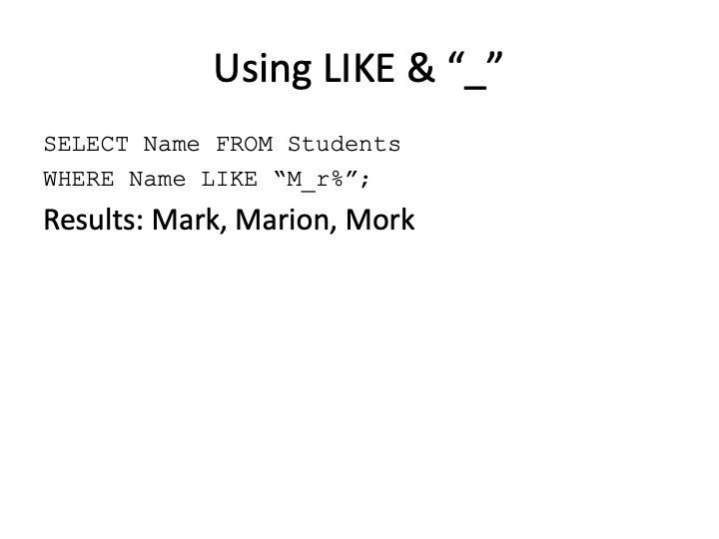

Slide 103
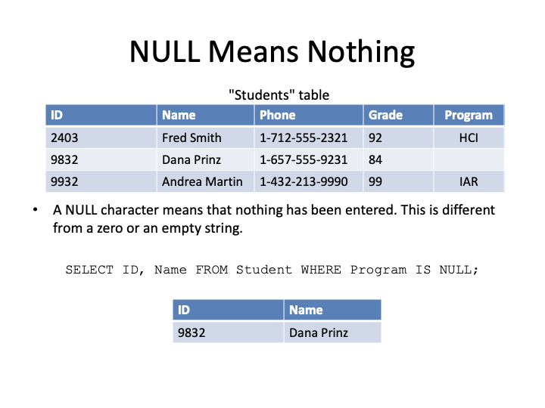

Slide 104
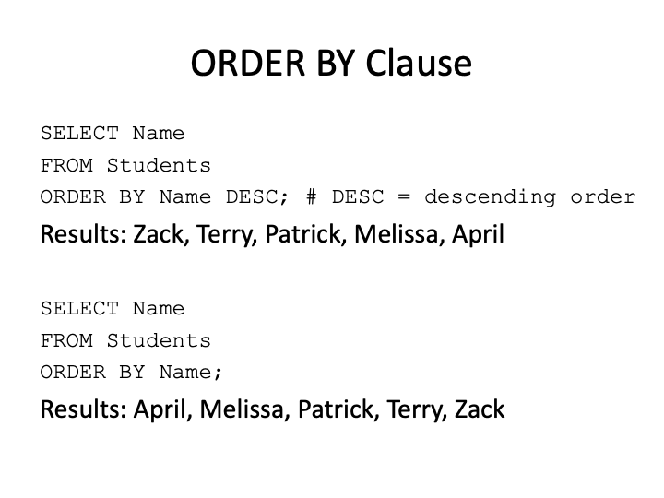

Slide 105
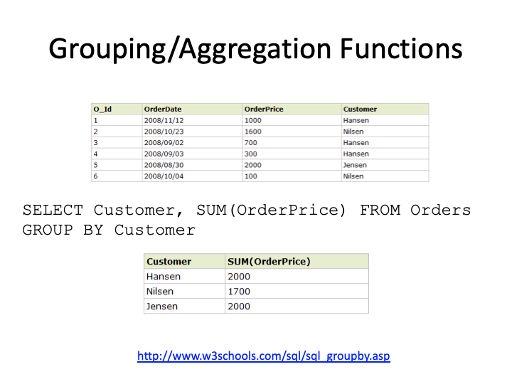

Slide 106
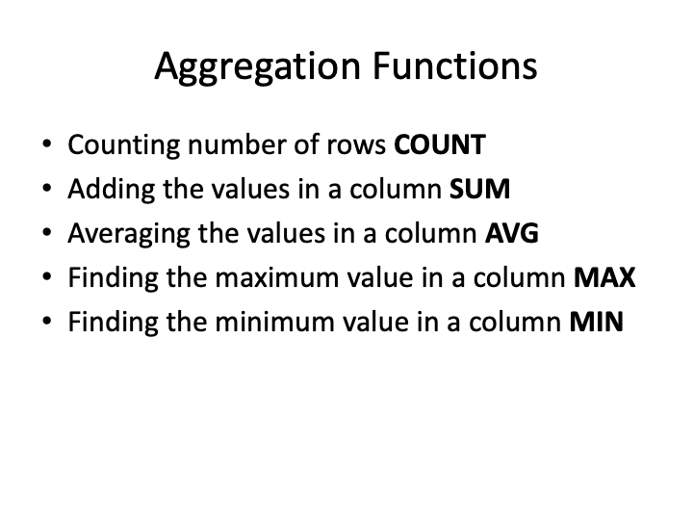

Slide 107
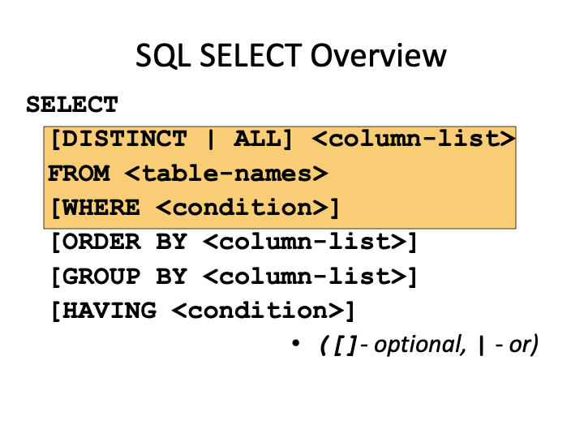

Slide 108
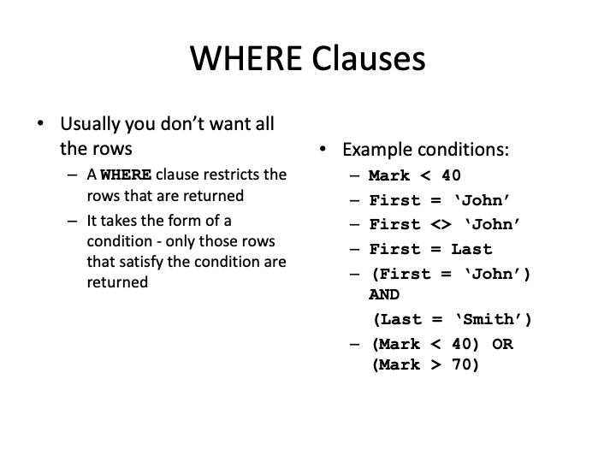

Slide 109
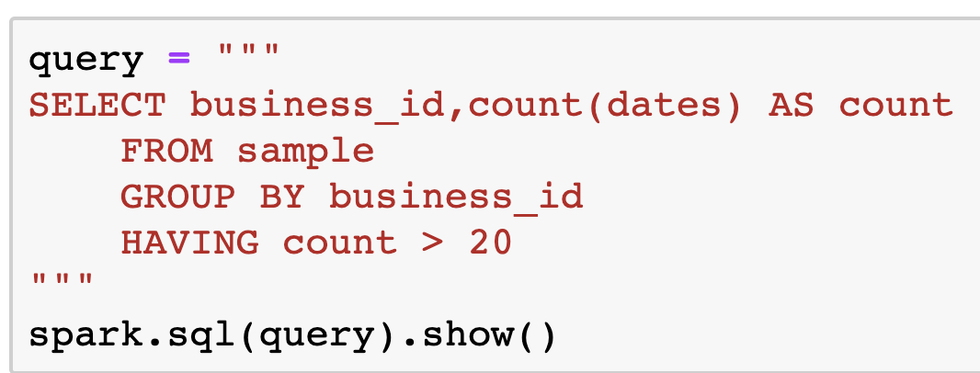
WHERE vs. HAVING
WHERE and HAVING take the same format of condition phrases
HAVING is used on the output of an aggregation from a GROUP BY

Slide 110
A few words about formatting
results = spark.sql("SELECT count(*) AS the_count FROM checkin WHERE business_id = '--1UhMGODdWsrMastO9DZw'")
quickly becomes unwieldy; can use line breaks:
results = spark.sql("SELECT count(*) AS the_count \ FROM checkin \ WHERE business_id = '--1UhMGODdWsrMastO9DZw'")
still a bit unwieldy

Slide 111
Triple-quoted strings
query = """ SELECT count(*) AS the_count FROM checkin WHERE business_id = '--1UhMGODdWsrMastO9DZw' """
just a string -- triple quotes are unlikely to be found "in the wild", so reasonable thing to use to surround strings
once you have a string, you can use it as a query

Slide 112
Sample Spark SQL Query
query = """ SELECT count(*) AS the_count FROM checkin WHERE business_id = '--1UhMGODdWsrMastO9DZw' """ results = spark.sql(query) results.show()
note that results is a Spark DataFrame (which is why we can use .show(), etc.)

Slide 113
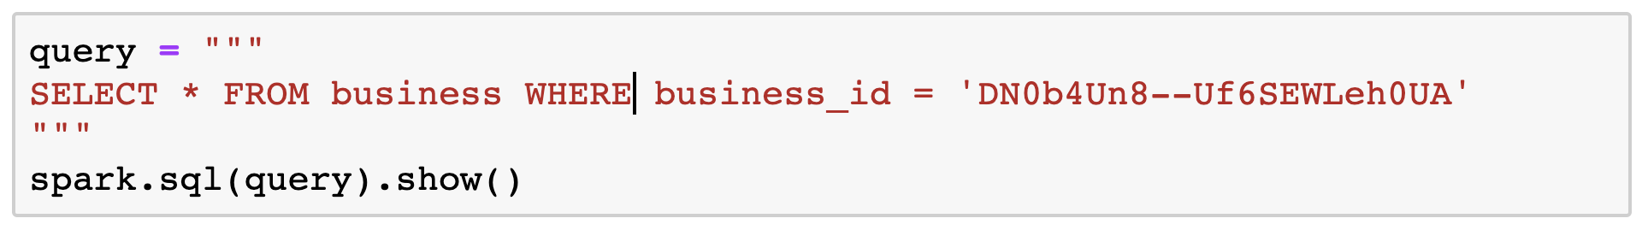
Simple SELECT

Slide 114
AS: Aliasing columns
results = spark.sql("SELECT business_id AS bid,\ trim(checkin_date) AS checkin_date \ FROM checkin \ WHERE business_id = '--1UhMGODdWsrMastO9DZw'")

Slide 115
TABLESAMPLE: Sampling a table
query = """ SELECT * FROM checkin TABLESAMPLE (1 PERCENT) """

Slide 116
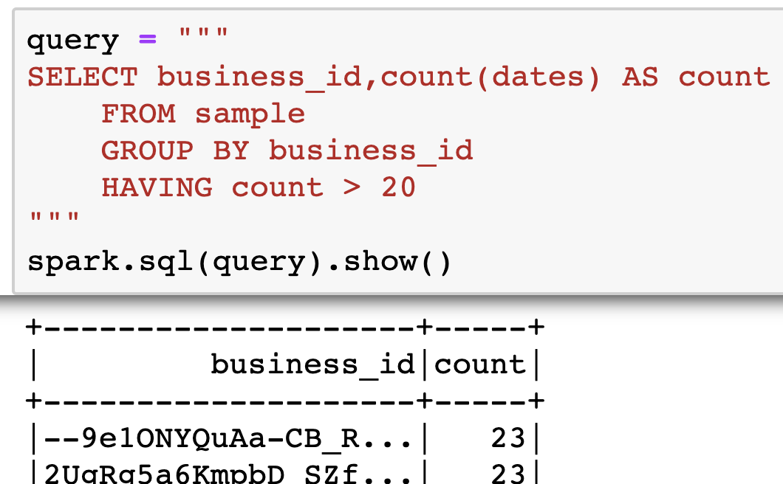
HAVING

Slide 117
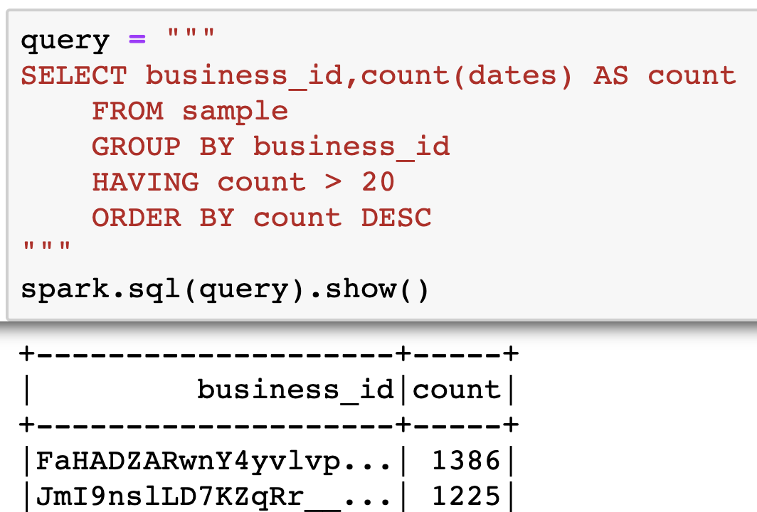
ORDERING

Slide 118
Joining tables
sometimes data are spread out over multiple tables (DataFrames)
can join tables together using "keys" (often some sort of unique ID)
this should be a review of what you covered in the SQL course
example: SELECT review.text, user.name FROM review LEFT JOIN user on review.user_id = user.user_id
conceptually, it's creating a larger table from smaller tables
directionality determines what to do with missing or repeated values

Slide 119
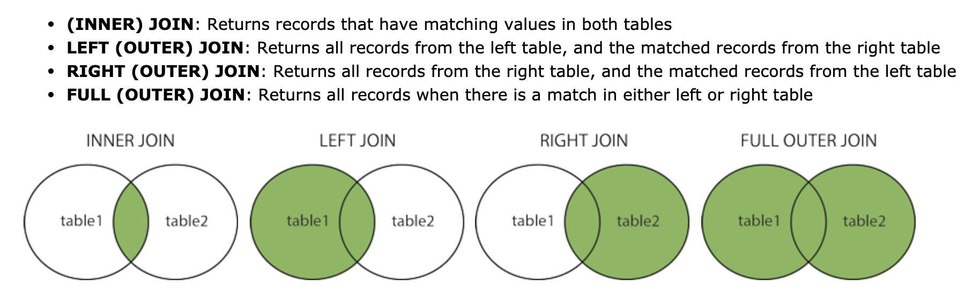
Join types
from https://www.w3schools.com/sql/sql_join.asp

Slide 120
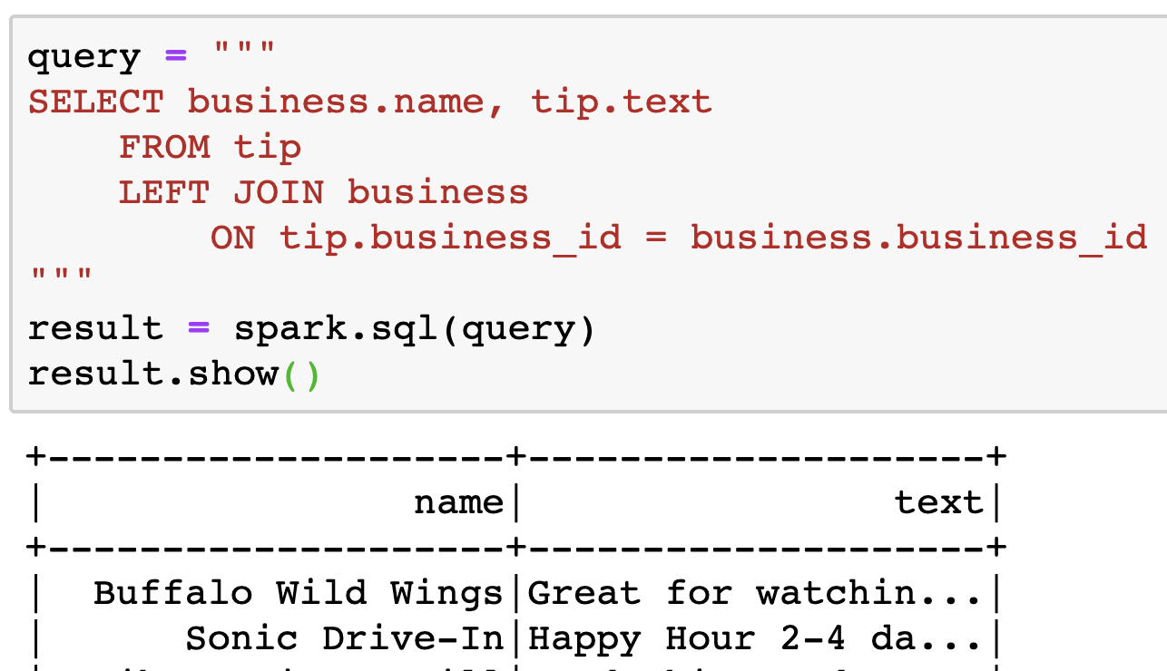
Sample JOIN

Slide 121
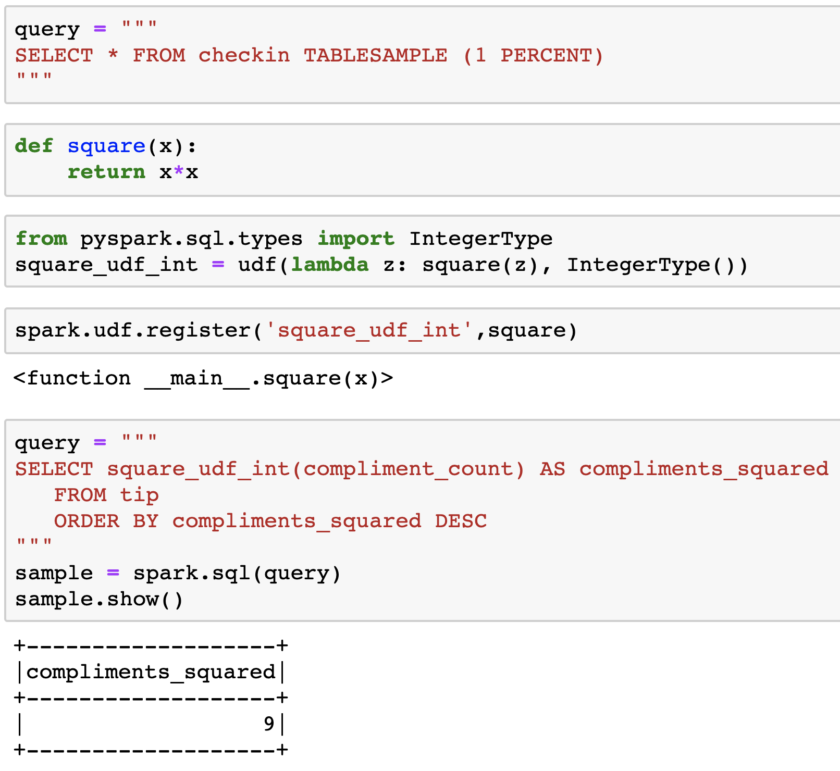
User-defined functions in Spark SQL
same idea as UDFs in Spark, but we need to register them so that the SQL interpreter knows what to do

Slide 122
Pandas interoperability
can always use .toPandas() on a Spark DataFrame to create a Pandas DataFrame
be careful (size)!
note that you can also go the other way (pandas to Spark) by initializing a Spark DataFrame with a pandas DataFrame

Slide 123
End of Big Data

Slide 124
Homework #8
take a look in Canvas
comprehensive review of all topics in course

Slide 125
Overview
Course review
Future work: courses and jobs

Slide 126
What you'll learn in SI 618
skills
how to get/read/fetch data
how to convert data to and from important formats
basic computation and manipulation of the data, including filtering and sorting
initial methods to explore and visualize to gain insights
how to apply python coding and packages to solve the above problems
tools
Jupyter
pandas, scikit-learn
basic statistical procedures
visualization (matplotlib, seaborn, maybe bokeh)
machine learning (dimension reduction, clustering and classification)
Big Data skills (Spark)

Slide 127
Jupyter
interactive python environment
based on IPython, which is an interactive python shell
designed as a web-based application
has seen widespread adoption
Jupyter notebooks
JupyterLab
Google Colab(oratory)
nteract
Visual Studio Code
file type is .ipynb (IPYthon NoteBook), which can be opened by VS Code
I like notebooks, but not everybody does.

Slide 128
Course Overview
Day 2: pandas Day 3: more pandas Day 4: applied statistics (corr & linear models), visualization (matplotlib, seaborn) Day 5: applied statistics (ANOVA, t-test) Day 6: applied statistics (categorical data), introduction to text processing Day 7: natural language processing Day 8: introduction to machine learning Day 9: machine learning: dimension reduction Day 10: machine learning: clustering Day 11: machine learning: classification Day 12: big data (dask) Day 13: spark

Slide 129
Resources
prerecorded materials (videos + notebooks)
quizzes
in-class notebooks
in-class "hands-on" time + recordings
homework
progressive

Slide 130
What's next?
more courses
jobs

Slide 131
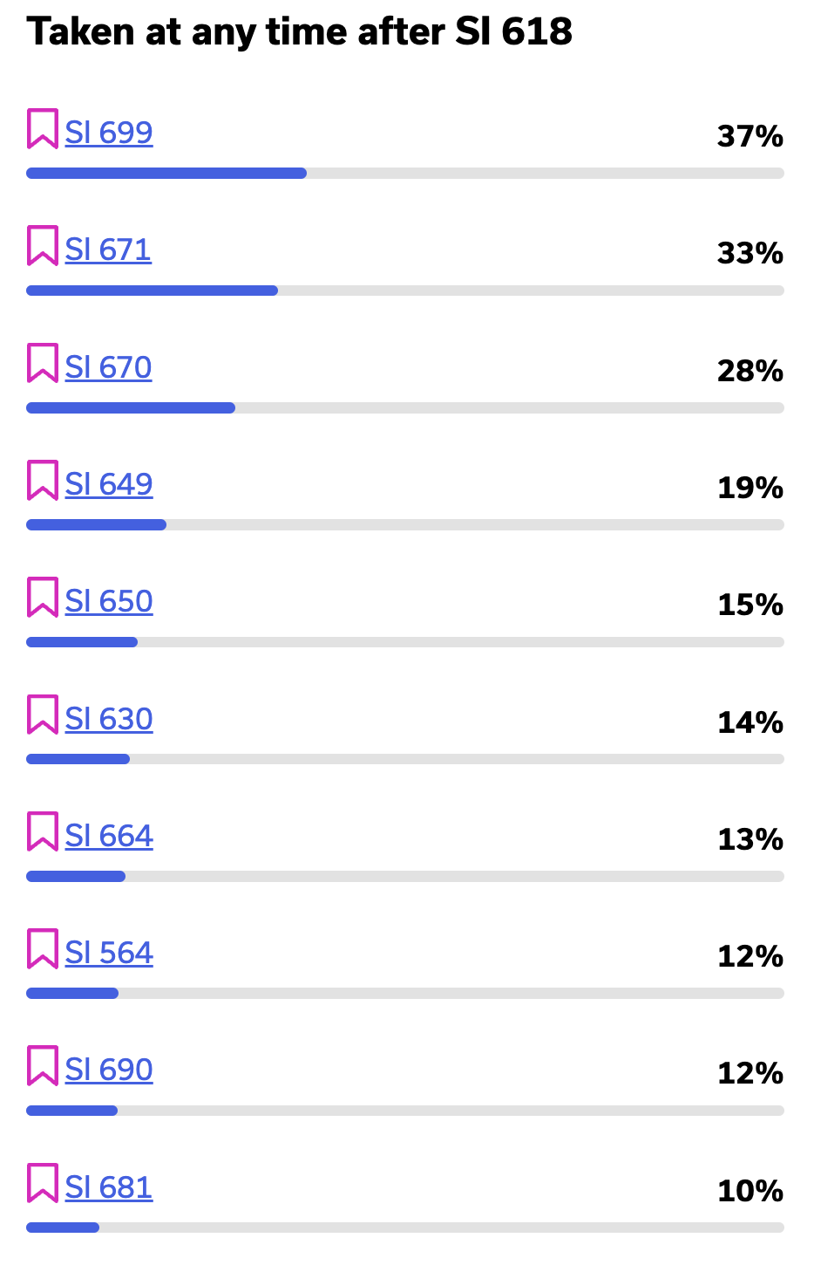
More courses
https://atlas.ai.umich.edu/course/SI 618/
671 (Data Mining)
670 (Applied Machine Learning)
649 (Information Visualization)
650 (Information Retrieval)
630 (Natural Language Processing)
690 (Internship)
608 (Networks)
564 (SQL and Databases)
664 (Database Applications)

Slide 132
Jobs
finding jobs
my hiring workflow

Slide 133
Finding jobs
"data science" isn't a particularly good search term
hint: try techniques, programming languages, tools, libraries, etc.
careers.umich.edu

Slide 134
My hiring workflow
generate job description
"required" vs "desired"
required: you MUST have these
desired: the more of these you have the better
qualifications
"you need 10 years of experience"
"but the technology has only existed for 3!"
count internship, research, etc. in your experience
computer science vs. information degrees
review applications
send out screener to qualified applicants
review screeners, interview best ones
make offer(s)

Slide 135
A HUGE thank you to our GSIs
Arjun Ananda Padmanabhan
Niloufar Sedarati
Wengran Xiao

Slide 136
Finally
Thank YOU for being a part of this iteration of SI 618!
Have a great break!

